Slide 1
Study of Amsterdam and Chicago Neighborhoods

Slide 2
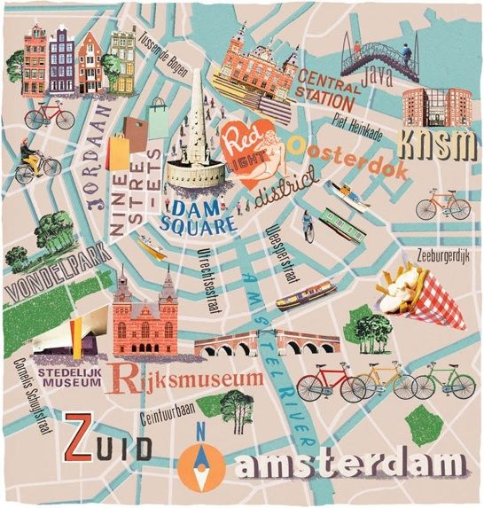
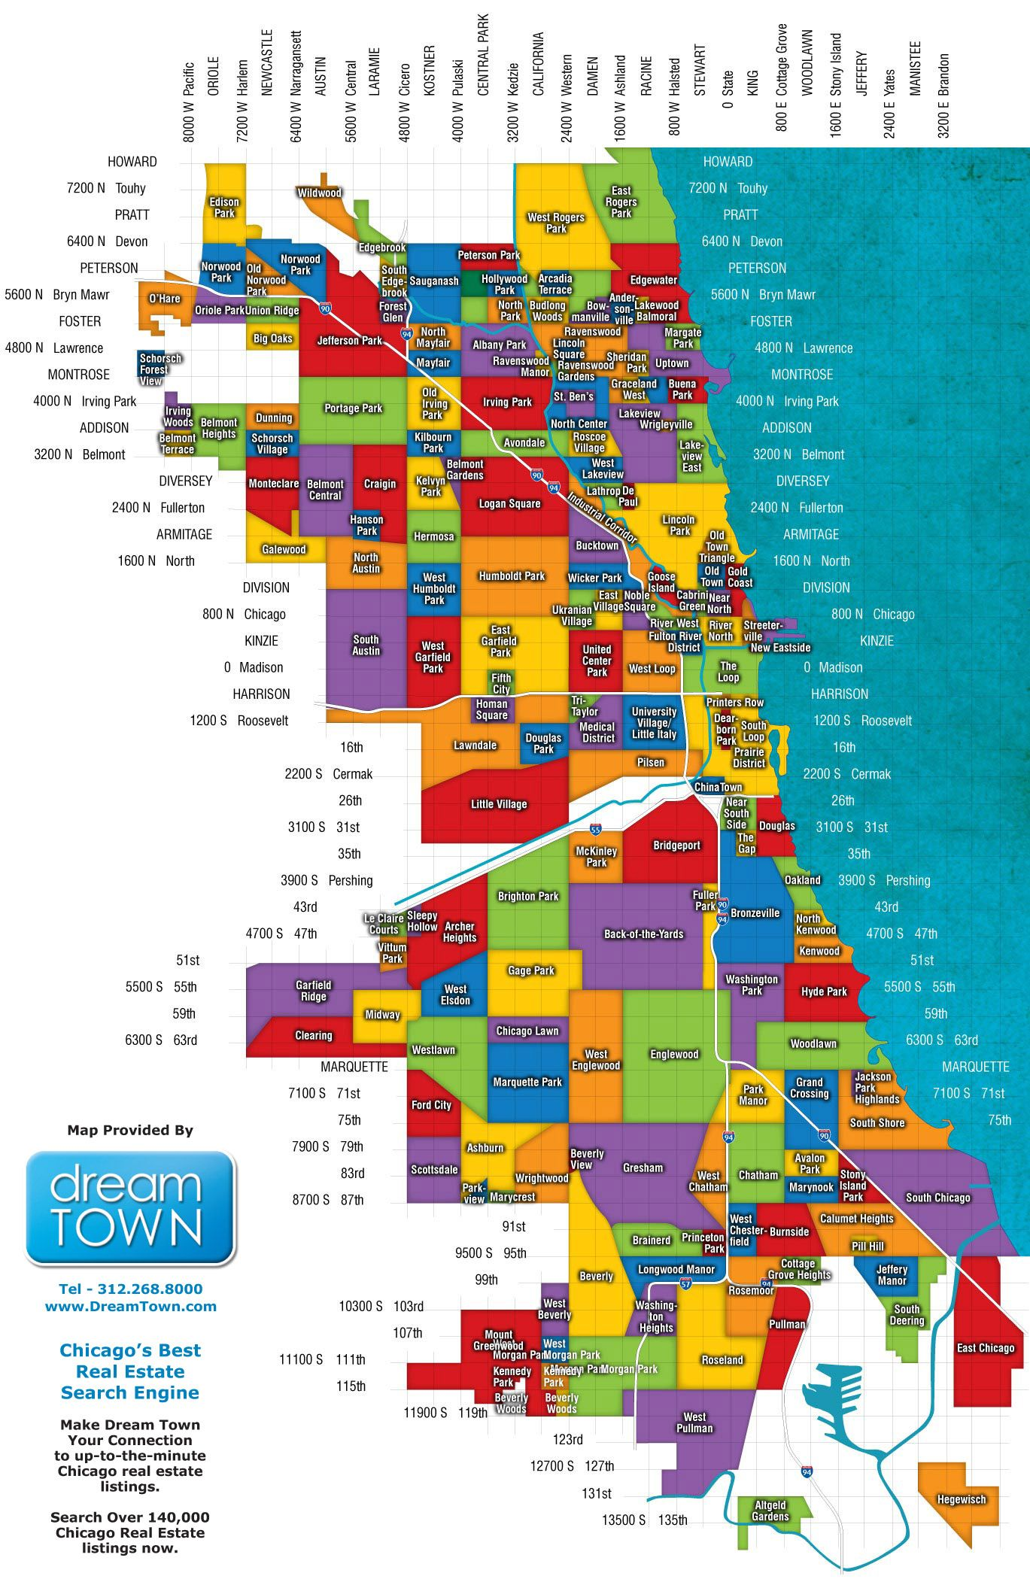
Introduction
A group of Americans from Chicago are moving to Amsterdam for work
None of them know anything about neighborhoods in Amsterdam and are uncertain about which neighborhoods they may prefer
They do know which neighborhoods they prefer in Chicago
They'd like to get a recommendation for which neighborhood in Amsterdam is most similar to each neighborhood in Chicago

Slide 3

Data
In order to help the group make more informed decisions, I will use the four-square data for each of the cities to retrieve venue type data by neighborhood
These neighborhoods will be defined by geojson files for each city that were found online

Slide 4


Methodology
I will use the neighborhood and venue data to calculate a value for each neighborhood pair based on similarity of venue type
I will then return the Amsterdam neighborhood that is most like each Chicago neighborhood.

Slide 5
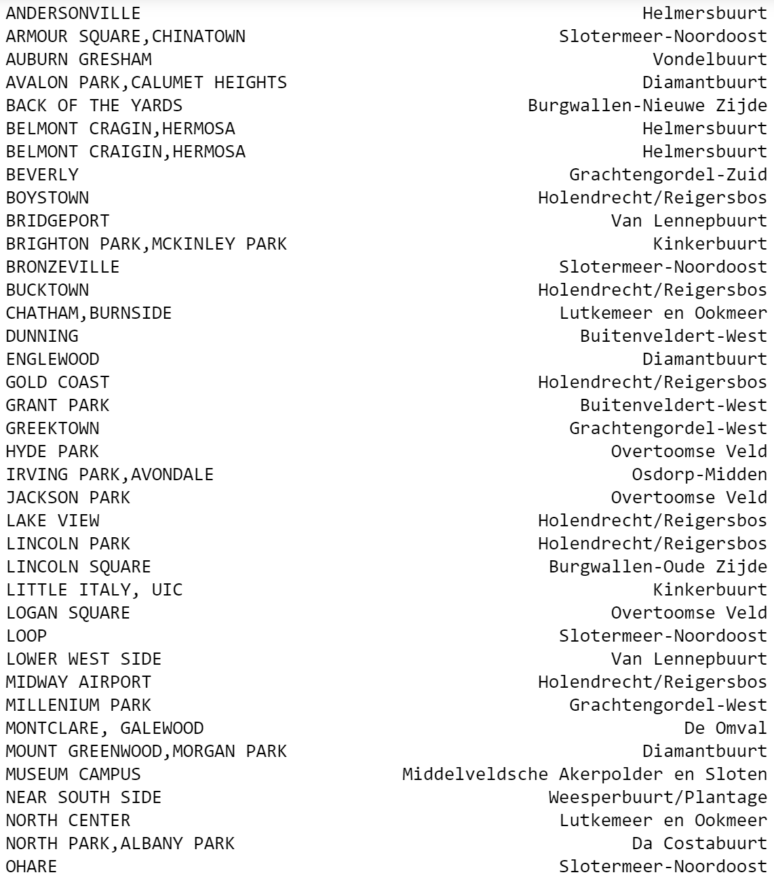
Results
The results of my project are two data frames containing each neighborhood from Chicago and Amsterdam along with their closest neighborhood match from the opposite city.

Slide 6
Discussion
The Americans from Chicago who are moving to Amsterdam are looking for a way to know which Amsterdam neighborhood is most like the Chicago neighborhood that they currently live in
This project was able to deliver this result by looking at four square data to see the most popular venues types in each neighborhood and then compare these values for each pair of neighborhoods
The result set from this project provides very useful data to the Americans who are moving to Amsterdam.

Slide 7
Conclusion
The result of this project is that anyone with knowledge of Chicago neighborhoods will be able to find the most similar neighborhood to a neighborhood they already know.

